Slide 1
XRD matching validation
Ryther Anderson

Slide 2
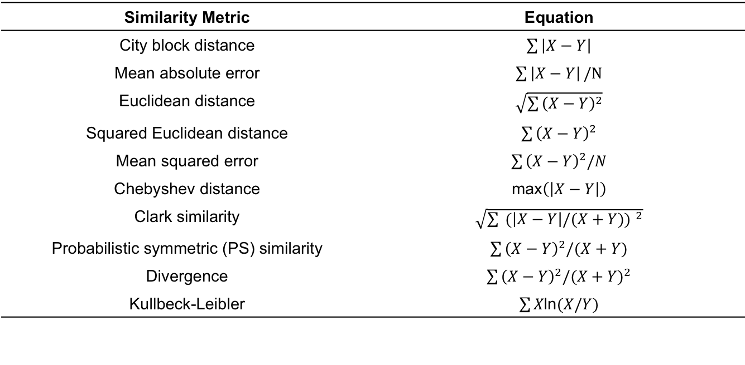
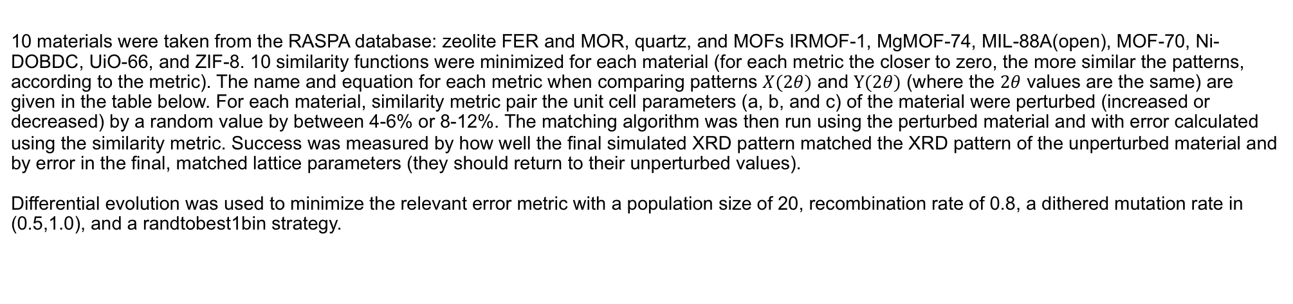
Testing procedure
10 materials were taken from the RASPA database: zeolite FER and MOR, quartz, and MOFs IRMOF-1, MgMOF-74, MIL-88A(open), MOF-70, Ni-DOBDC, UiO-66, and ZIF-8. 10 similarity functions were minimized for each material (for each metric the closer to zero, the more similar the patterns, according to the metric). The name and equation for each metric when comparing patterns $X(2θ)$ and $Y(2θ)$ (where the $2θ$ values are the same) are given in the table below. For each material, similarity metric pair the unit cell parameters (a, b, and c) of the material were perturbed (increased or decreased) by a random value by between 4-6% or 8-12%. The matching algorithm was then run using the perturbed material and with error calculated using the similarity metric. Success was measured by how well the final simulated XRD pattern matched the XRD pattern of the unperturbed material and by error in the final, matched lattice parameters (they should return to their unperturbed values).
Differential evolution was used to minimize the relevant error metric with a population size of 20, recombination rate of 0.8, a dithered mutation rate in (0.5,1.0), and a randtobest1bin strategy.
Similarity Metric | Equation
City block distance | $\sum_{ }{\left|X−Y\right|}$
Mean absolute error | $\sum_{ }{\left|X−Y\right|}/N$
Euclidean distance | $\sqrt{\sum_{ }{{\left(X−Y\right)}^{2}}}$
Squared Euclidean distance | $\sum_{ }{{\left(X−Y\right)}^{2}}$
Mean squared error | $\sum_{ }{{\left(X−Y\right)}^{2}/N}$
Chebyshev distance | $\text{max}\left(\left|X−Y\right|\right)$
Clark similarity | $\sqrt{\sum{ }{(\left|X−Y\right|/(X+Y)) }^{2}}$
Probabilistic symmetric (PS) similarity | $\sum_{ }{{\left(X−Y\right)}^{2}/(X+Y)}$
Divergence | $\sum_{ }{{\left(X−Y\right)}^{2}/{(X+Y)}^{2}}$
Kullbeck-Leibler | $\sum{X\text{ln}(X/Y)}$

Slide 3
Testing results: pattern matching
MAE
MSE
PS similarity
N iterations
4-6% perturbed
8-12% perturbed
Fig 1. Final pattern similarity metrics (indicated) for minimizations according to the error functions on the x-axis for both 4-6% and 8-12% initial perturbations. Each boxplot corresponds to the 10 materials used for testing. The three error functions resulting in the lowest value for each metric is colored according to the legend.

Slide 4
Testing results: pattern matching
Fig 2. The average percent error across (a,b,c) for each MOF and each error function for both 4-6 and 8-12% initial perturbations (indicated).

Slide 5
Brief Analysis
Fig. 1 indicates that Euclidean distance results in the best pattern matching according to MAE, MSE, and PS similarity, even when directly minimizing MAE, MSE or PS similarity. Further, convergence was achieved more quickly using Euclidean distance as the error metric than other high-performing metrics. All error functions produced adequate matching except for Chebyshev distance, Clark similarity, and divergence.
Fig. 2 shows that no single error metric resulted in perfect matching of the lattice parameters for every material with an 8-12% initial perturbation. The materials that tended have worse final matching (MgMOF-74, MOF-70, and Ni-DOBDC) have much shorter c-vectors (~6.0 Å) than a or b vectors (~25 Å), meaning that peaks from reflections with large components in the ab-plane tended to be much less intense than early peaks. Thus, even though high similarity was achieved between the initial and matched XRD patterns for all error functions, the error in the c-vector length was often relatively large. Nonetheless, for every material near-perfect matching was achieved using some error metric. The lowest error (on average) in unit cell parameters for 4-6% initial perturbations was achieved using PS similarity (median 0.079%), followed closely by city block distance (0.090%), MAE (0.102%), MSE (0.197%), and Euclidean/squared Euclidean distance (both 0.200%). The lowest error (on average) in unit cell parameters for 8-12% initial perturbations using city block distance (median 0.114%) followed by MAE (0.170%) and Euclidean distance (0.180%).
These results indicate that different error functions can yield results of similar (high) quality. However, PS similarity is likely to give the best unit cell parameter matching when near the ”correct” parameters (4-6% away). Given that this can be difficult to assess a priori city block distance is likely the “safest” error metric as good matching between both unit cell parameters and XRD patterns was obtained for both 4-6 and 8-12% initial perturbations using city block distance. Other good choices are Euclidean distance, squared Euclidean distance, and MAE. Chebyshev distance, Clark similarity, and divergence should be avoided. Although divergence may be appropriate for an initial optimization as optimizations using divergence tended to converge much faster than optimizations using other error metrics (while maintaining reasonable matching quality, unlike Clark similarity).

